Slide 1
Y
1
2
3
W
4
5
6
S
7
8
9
Notes:
Click on a numbered square to make the square disappear.
Click on the image to reveal it. All the squares will disappear.

Slide 2
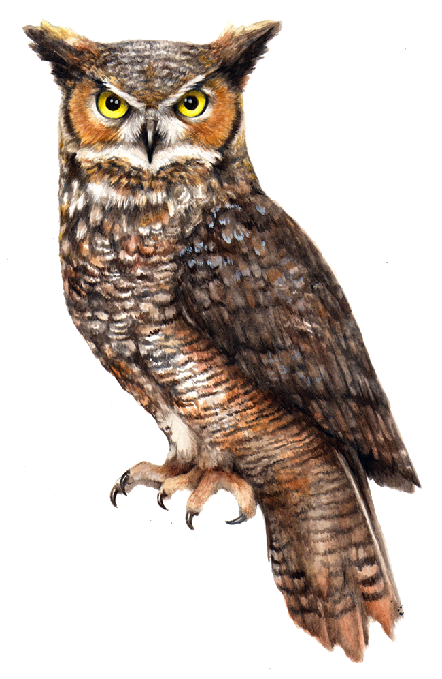
1
F
2
3
4
5
6
7
8
9
Notes:
Click on a numbered square to make the square disappear.
Click on the image to reveal it. All the squares will disappear.

Slide 3
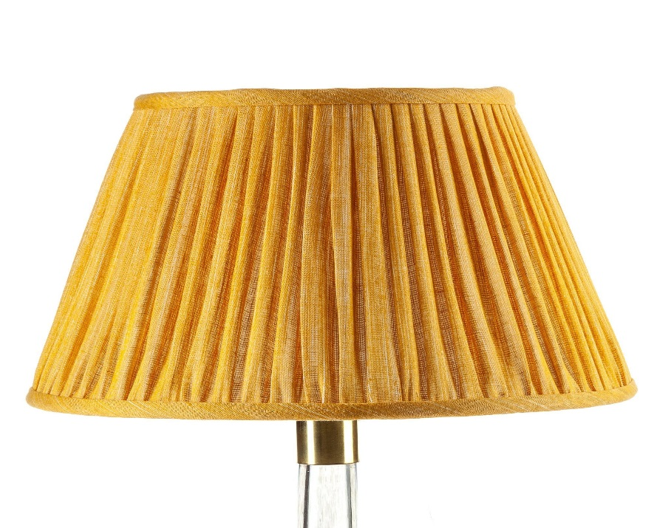
Roman Numeral
D
1
2
3
4
5
6
Z
7
8
9
Notes:
Click on a numbered square to make the square disappear.
Click on the image to reveal it. All the squares will disappear.

Slide 4
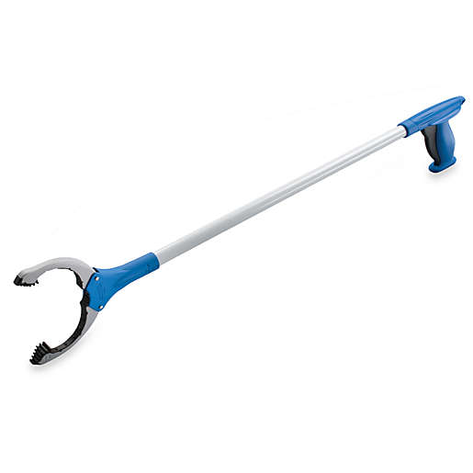
1
2
3
4
5
6
Z
7
8
9
Notes:
Click on a numbered square to make the square disappear.
Click on the image to reveal it. All the squares will disappear.

